Slide 1
KUBERNETES
VIKAS

Slide 2
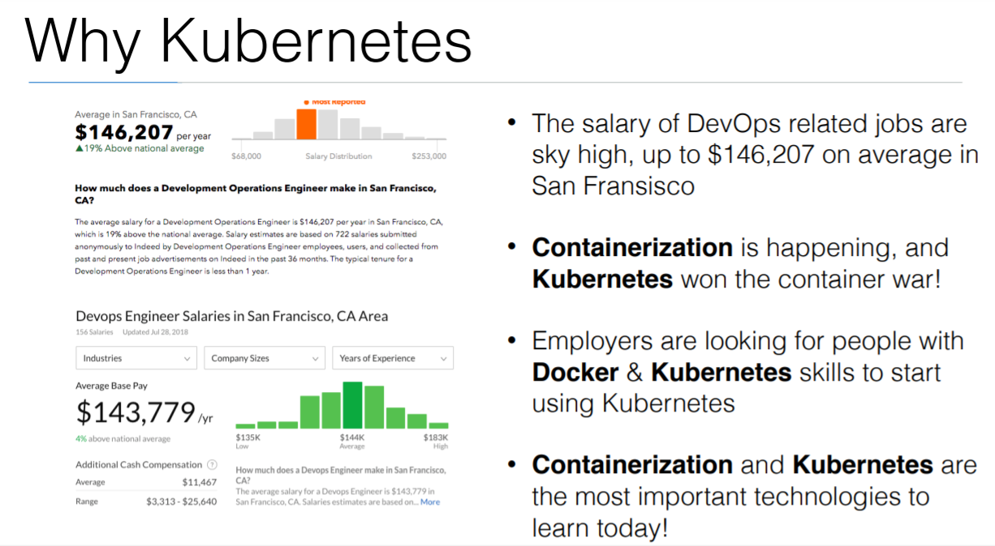

Slide 3
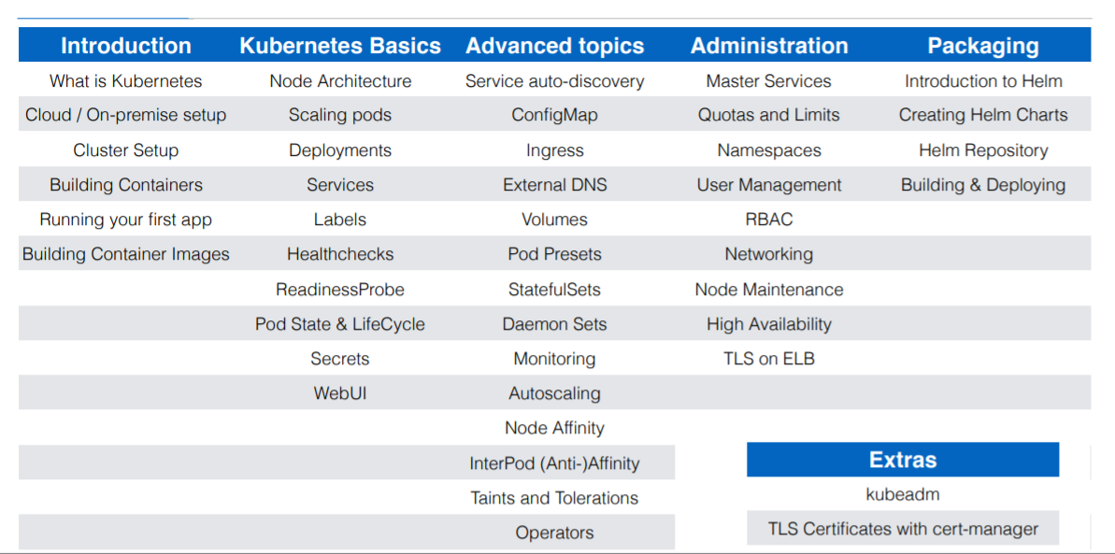

Slide 4
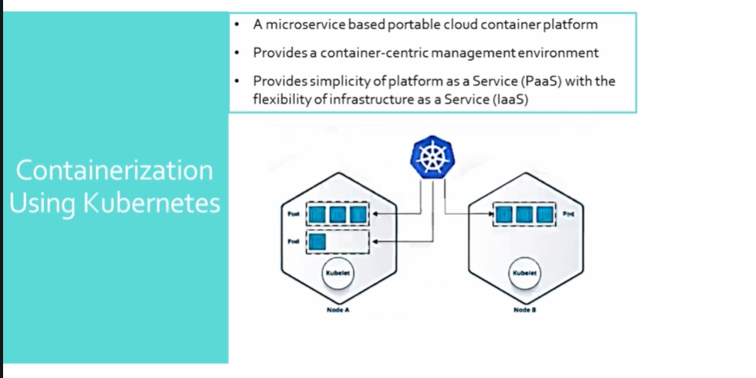

Slide 5
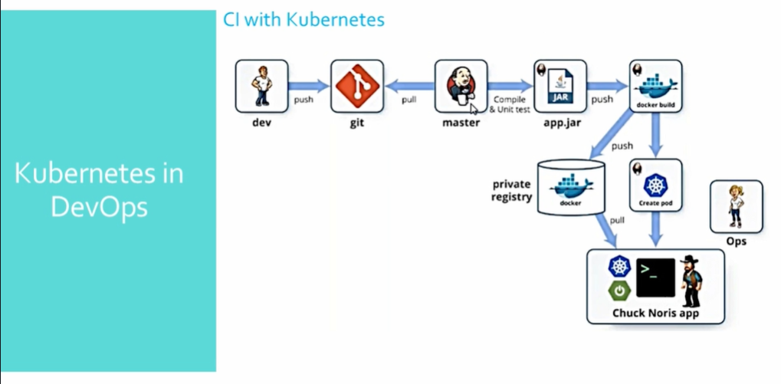

Slide 6
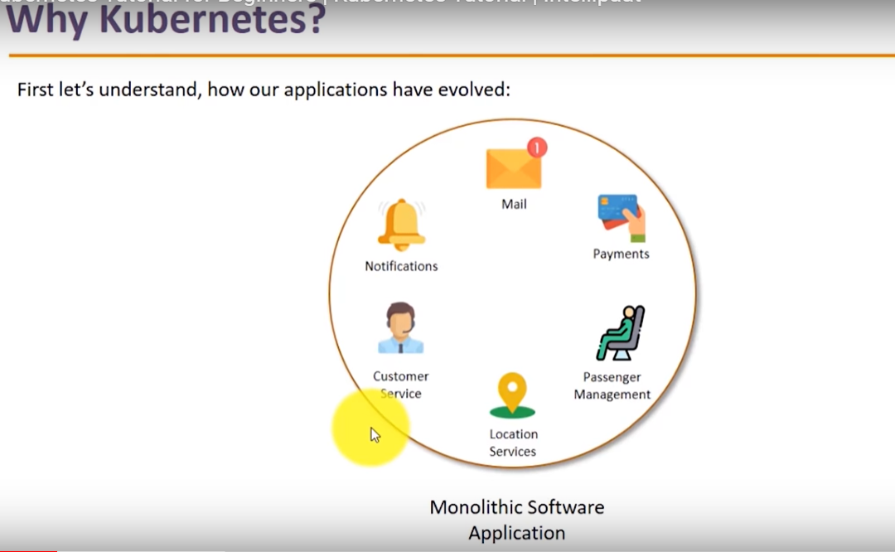
Notes:
Maven
Git
Jenkins

Slide 7
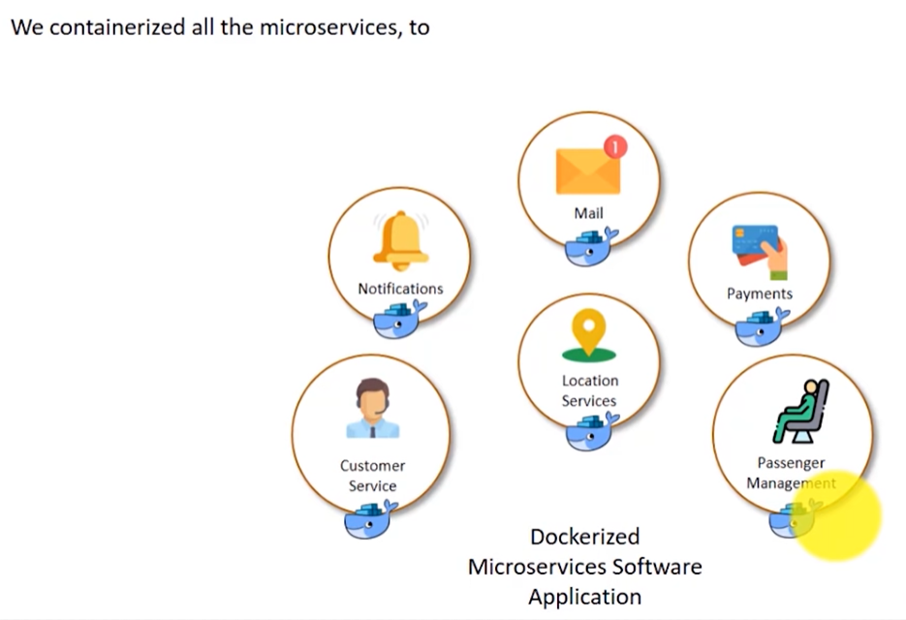
Notes:
Micro services can exist independently and changing one doesn't affect other .Services can be in different language and connected over internet .
Robust
Replaceable and reusable
Scalable
Easy to deploy
Now service monitoring is a issue .
Scaling up on load basis was not possible .
Too much manual intervention for managing containers .
Managing containers at multiple server is difficult .

Slide 8
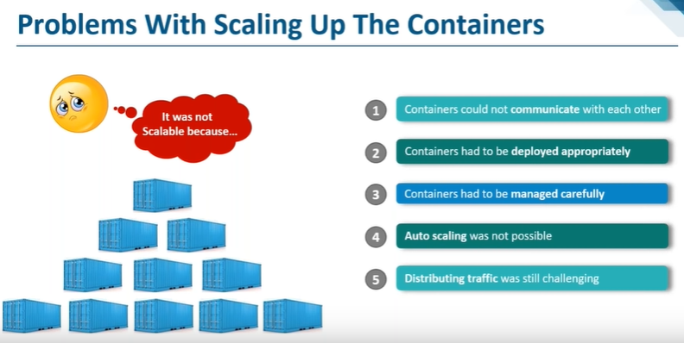
Notes:
Handling Monolithic application to handling micro services .
Micro services can be up scaled but problem with down scaling .

Slide 9
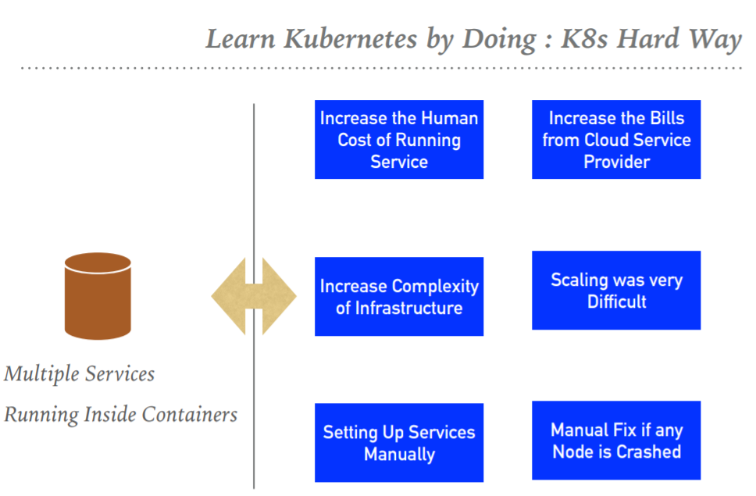
Notes:
Containers needs to be managed and connected to the outside world for task such as scheduling ,load balancers , and distribution and this is where a container orchestration tool like Kubernetes comes into picture .Kubernetes handles the work of scheduling containers onto a compute cluster and manage the workloads to ensure they run as user intends .
Features of Kubernetes –
➤ Automated Scheduling : Kubernetes provides advanced scheduler to launch container on cluster nodes based on their resource requirements and other constraints.
➤ Healing Capabilities: Kubernetes allows to replaces and reschedules containers when nodes die. Kubernetes doesn’t allow Containers to use, until they get ready.
➤ Auto Upgrade and Rollback : Kubernetes rolls out changes to the application or its configuration. Monitoring Application ensure that Kubernetes doesn’t kill all Instance at that time. If something goes wrong, with Kubernetes you can rollback the change.
➤Horizontal Scaling : Kubernetes can scale up and scale down the application as per the requirements with a simple command, using a UI, or automatically based on CPU usage.
➤ Storage Orchestration : With Kubernetes, you can mount the storage system of your choice. You can either opt for local storage, or choose a public cloud provider.
➤ Secret & Configuration Management : Kubernetes can help you deploy and update secrets and application configuration without rebuilding your image and without exposing secrets in your stack configuration.
https://github.com/vikas99341/Kubernetes_Devops.git

Slide 10
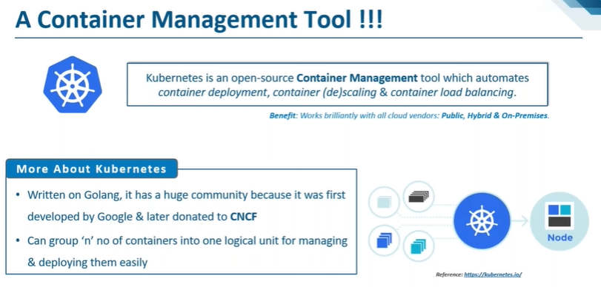
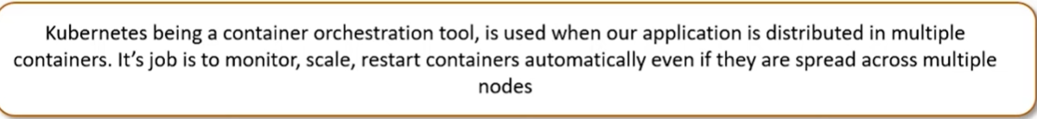
Notes:
Kubernetes (K8s) is an open-source container orchestration engine for automating deployment , scaling, and management of containerized applications .It originated from Google open sourced under Apache 2.0 License and now is hosted by the Cloud Native Computing Foundation (CNCF). It comes from a Greek word helmsman (Person who steers ship).
Orchestrator : Manages containerized apps at any level . Give the app and say how should it look like .K8s will make the hard decision about where to run the container and how to keep it running.
Features :
Automatic bin packing : Places resources based on requirement and availability to make a single unit .
Service discovery and Load Balancing : no need to worry about networking .
Storage orchestration : Mount a storage system of your choice .
Self-Healing : when one the containers fail it will restart them of its own .Node failure is handled .
Batch Execution : Manage batch and CI workload .
Secret and configuration management : Don’t have to rebuilt the entire container on failure no need to expose the secret configurations .
Horizontal scaling
Automatic rollback and rollout : not all instances are updated at the same time .
Robust and reliable
Backed by huge google community
Container orchestration platform
Best solution for scaling up containers .

Slide 11
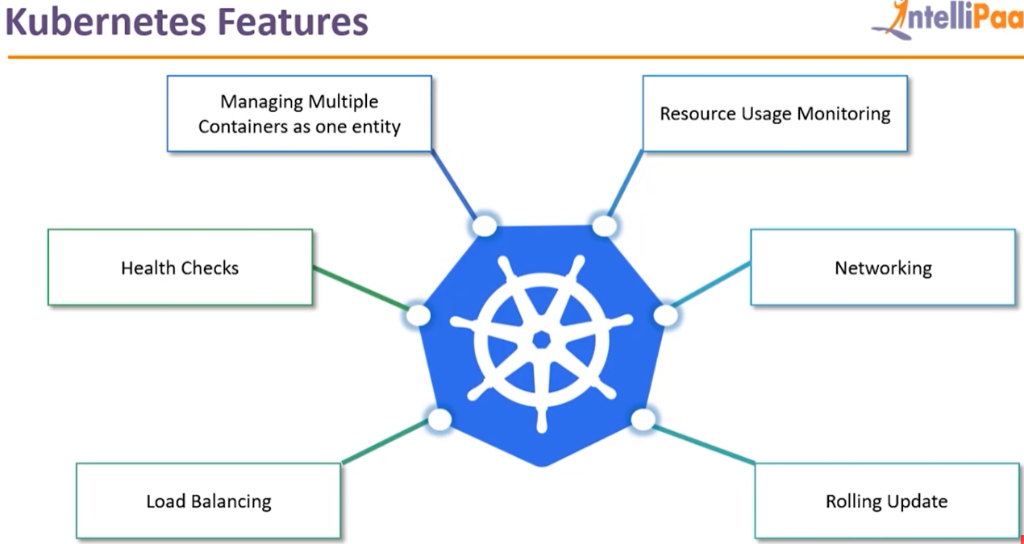
Notes:
Automated scheduling
Self healing capacity
Automated rollout and rollback
Horizontal scaling and load balancing .

Slide 12
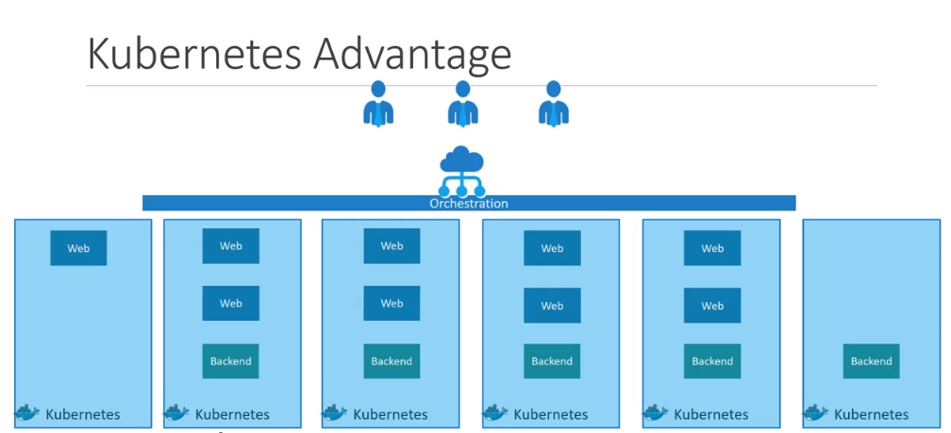
Notes:
Kubernetes Concepts - https://kubernetes.io/docs/concepts/
Pod Overview- https://kubernetes.io/docs/concepts/workloads/pods/pod-overview/

Slide 13
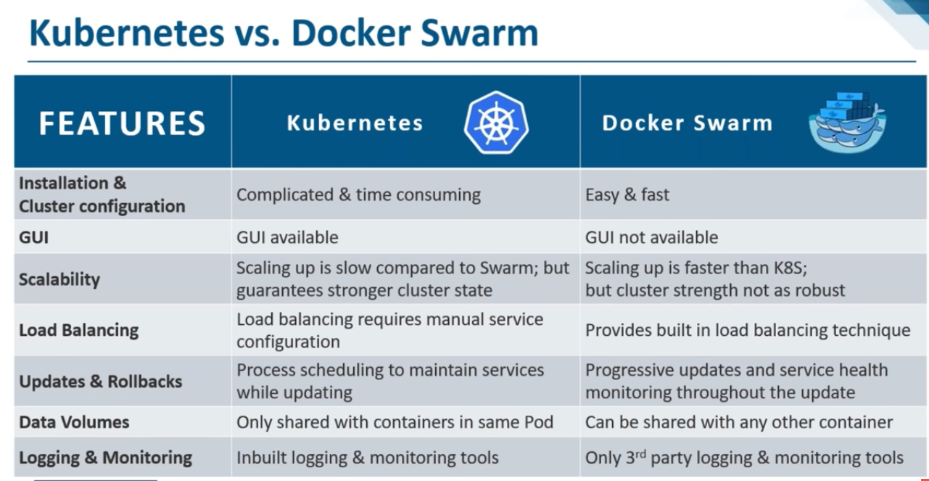

Slide 14
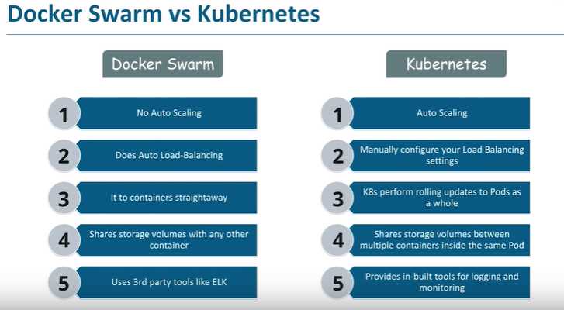

Slide 15
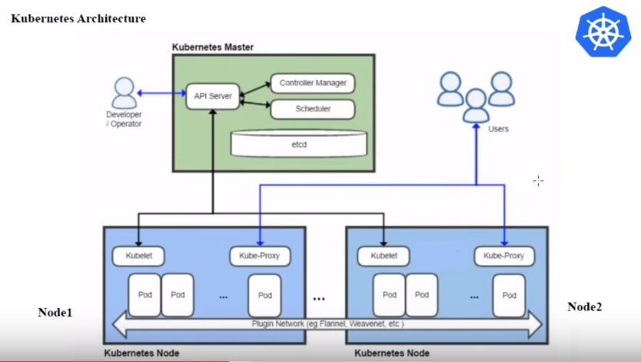
Notes:
Command to install kops :
https://kubernetes.io/docs/getting-started-guides/kops/
function install_kops {
if [ -z $(which kops) ]
then
curl -LO https://github.com/kubernetes/kops/releases/download/$(curl -s https://api.github.com/repos/kubernetes/kops/releases/latest | grep tag_name | cut -d '"' -f 4)/kops-linux-amd64
chmod +x kops-linux-amd64
mv kops-linux-amd64 /usr/local/bin/kops
else
echo "kops is most likely installed"
fi
}
install_kops
install kubectl binary to Linux like OS
KUBECTL_BIN=kubectl
function install_kubectl {
if [ -z $(which $KUBECTL_BIN) ]
then
curl -LO https://storage.googleapis.com/kubernetes-release/release/$(curl -s https://storage.googleapis.com/kubernetes-release/release/stable.txt)/bin/linux/amd64/$KUBECTL_BIN
chmod +x ${KUBECTL_BIN}
sudo mv ${KUBECTL_BIN} /usr/local/bin/${KUBECTL_BIN}
else
echo "Kubectl is most likely installed"
fi
}

Slide 16
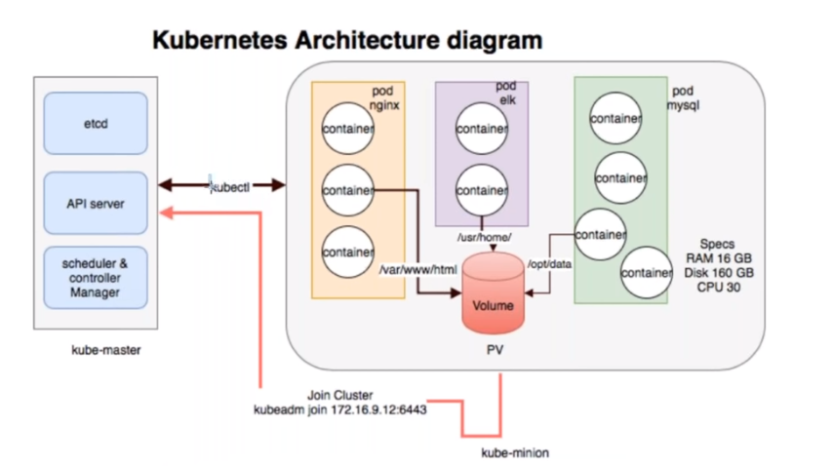

Slide 17
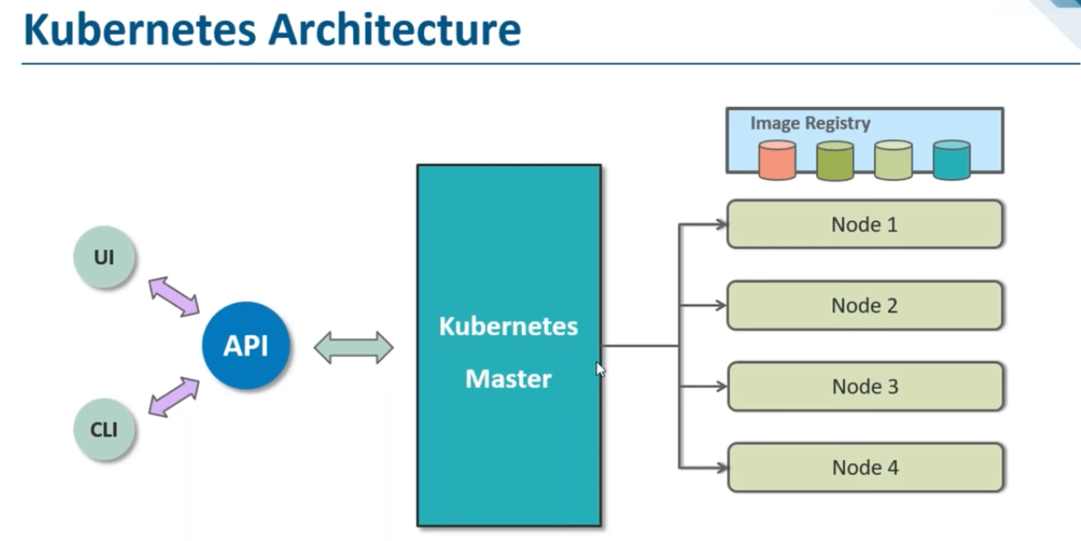
Notes:
Node – virtual or physical machine also known as minions .
Cluster – Master node + n numbers of worker nodes
Pod is one or multiple containers .
Deployment – number of containers you want along with the images which should be present inside pod .
Service is a internal load balancer for all pods running .
Ingress will segregate the url redirect .

Slide 18
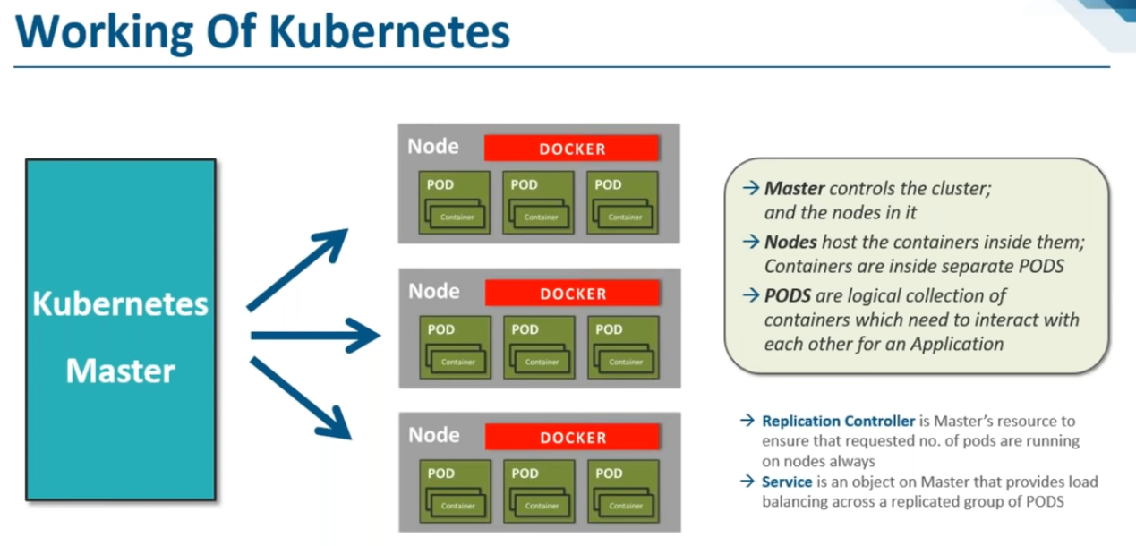
Notes:
Master node is responsible for the management of kubernetes clusters .This is a entry point for all administrative tasks .This will take care of orchestrating the worker nodes where actual service are running .
Components of Kubernetes : this all comes when you install K8S .
--------------------------------
Cluster state is managed by etcd .If you have multiple master nodes, they are connected to each other by etcd .
Etcd -- > stores cluster state (all master and worker node information ) in distributed key value format .Helps in log implementation so no conflicts are there . Used as Back-End for K8s. Provides high availability of Data related to Cluster State.
API Servers - It’s the front end for K8s .It acts as entry point for all REST Commands used to control the cluster .Will basically perform all the administrative tasks .
Scheduler -- distributes work/container across all the nodes. Regulates the tasks on slave nodes. Stores the resource usage information for each slave node.
Controller – they are the brain behind orchestration . Decides the state of a container and manages the deleted ones .It checks if the current state is matching with the desired state or else it will take a corrective measure . Runs multiple Controller utility in single process. Carry on Automated tasks in K8s Cluster
Worker Node : It’s a physical server or you can say a VM where the container managed by the Cluster Run. Worker nodes contain all the necessary services to manage the networking between the containers, communicate with the master node, and assign resources to the scheduled containers.
Kubelet : K8s Agent executed on the worker nodes. Kubelet gets the configuration of a Pod from the API server and ensures that the described containers are up and running.
Pods : Is a group of one or more containers with shared storage/network, and a specification for how to run the containers. Share the Same Shared content and same IP but reach other Pods via Localhost. Single Pod can Run on Multiple Machines and Single Machine can Run Multiple Pods.
Kube-Proxy : Kube-proxy runs on each node to deal with individual host sub-netting and ensure that the services are available to external parties. Kube-proxy acts as a network proxy and a load balancer for a service on a single worker node.

Slide 19
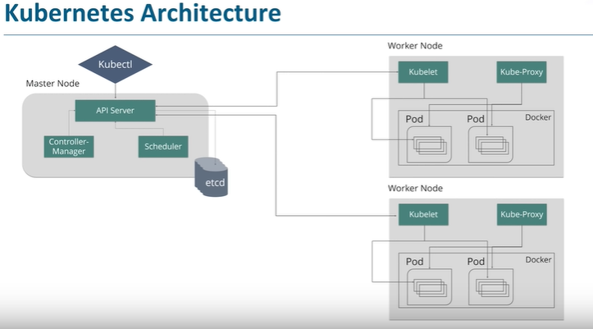
Notes:
From k8s-management connect to Master. Create these on master .
kubectl get nodes
kubectl get pods -o wide
kubectl get deploy - No initial but with deploy you get pods
kebectl get service
kubectl apply -f vikas-deploy.yml
kubectl apply -f vikas-service.yml

Slide 20
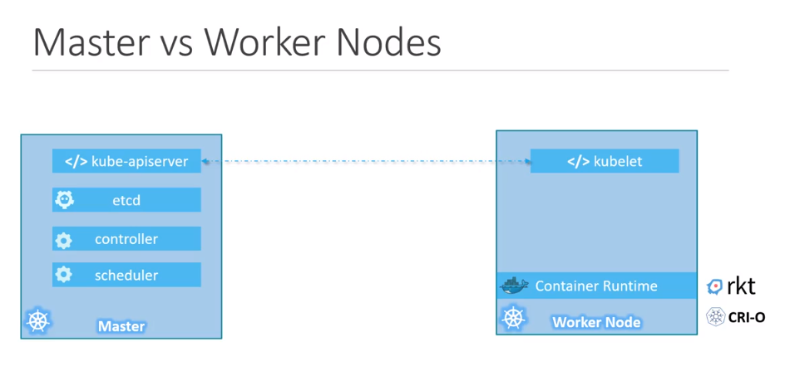
Notes:
Cluster has master node which had API Server ,Controller Manager ,Scheduler and ETCD connected .
Various worker nodes run under 1 master node .They have kubelet process running with kube-proxy and n number of pods running .
POD is a single instance of an application .It is the smallest object you create on K8S . Pods contains n number of containers which basically hosts application and are co-located and co-scheduled.
Kubelet – agent which communicates with master node and executes commands on the worker node . It gets the pods specification to the API server and executes the containers associated with POD .Ensures containers are healthy and running . command line proxy through which you can access all your cluster services and worker nodes .If a POD fails on a node this kubelet is not responsible restarting or finding another node but this will just inform the master .
Kube-Proxy -- > Ensures services are available to external parties .It servers as a network proxy and load balancer as every pod gets its own unique IP .
Kubectl – cli to communicate from API in Master .Deploy and manage applications on k8s cluster and collect status of other node .
example :
Kubectl run hello-minikube – Deploy minkube application on cluster .
Kubectl run nginx --image nginx – creates a docker container by creating a pod .
Kubectl cluster-info – view information about cluster .
Kubectl get nodes – list all the nodes in the cluster
Kubectl get pods -- get you the list of pods running
Kubectl describe pods – more details .
Kubectl get pods –o wide – get ip details for each pod

Slide 21
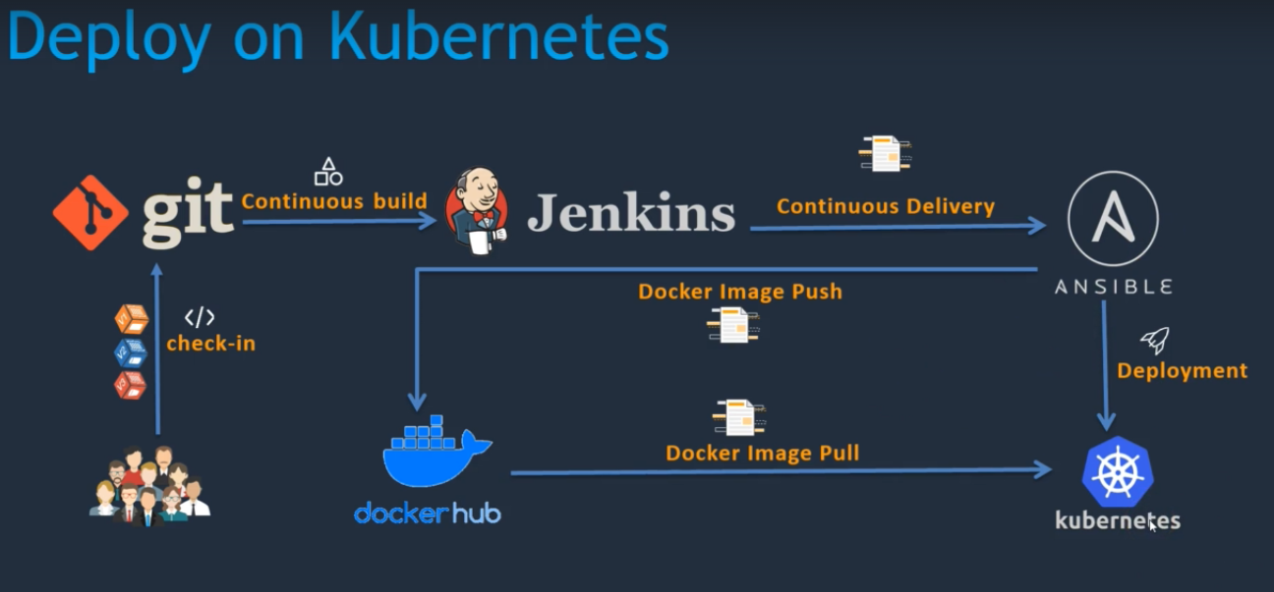
Notes:
Setup Kubernetes(K8s) on AWS : kubernetes-setup.MD
-----------------------------------
Launch Ubuntu server 18.04 with port 80 , 8080 and 22 .
Sudo su
Download AWS CLI as in the document
Check with aws --version
Check with kubectl –help
Check with kops
Create a role with EC2,S3,IAM & Route53 full access .Attach this to your EC2 Instance .
Create a Route53 private hosted zone
create an S3 bucket
export KOPS_STATE_STORE=s3://<Bucket_Name>
Create sshkeys before creating cluster == > ssh-keygen from root

Slide 22
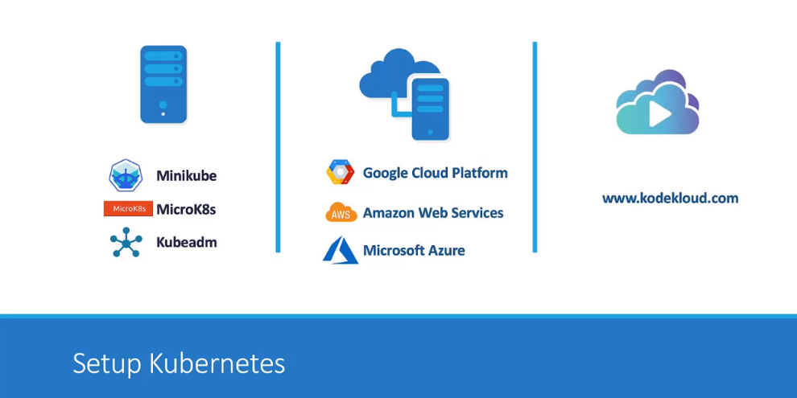
Notes:
You can Run Kubernetes Anywhere:
On-Premise(Own DataCenter)
Public Cloud(Google, AWS, Azure, DigitalOcean…)
Hybrid Cloud
https://kodekloud.com/p/public-labs?scenario=kubernetes-for-beginners-basiccommands-test
Using kubectl command
Writing deployment and service files
Creating Ansible playbook to deploy
Run a Jenkins job

Slide 23
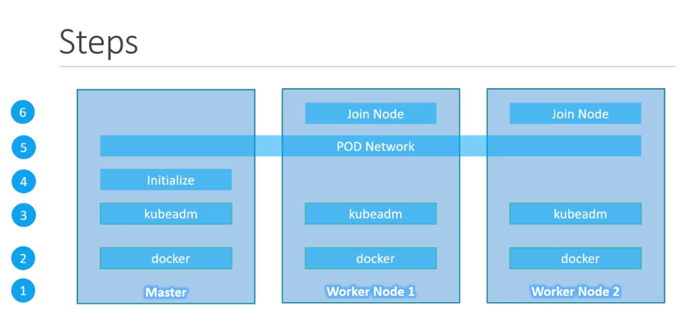
Notes:
https://kubernetes.io/docs/setup/independent/install-kubeadm/
kubectl create -f https://raw.githubusercontent.com/coreos/flannel/master/Documentation/kube-flannel.yml
Kubernetes on Google Cloud: https://cloud.google.com/kubernetes-engine/docs/
Labs.play-with-k8s.com
=========================================
Master – t2 medium with Ubuntu and port 22 , 80 , 8080(kubelet service) , 443 , 6783(running pods on slave nodes) , 6784(running pods on slave nodes) ,6443(joining nodes ) .

Slide 24
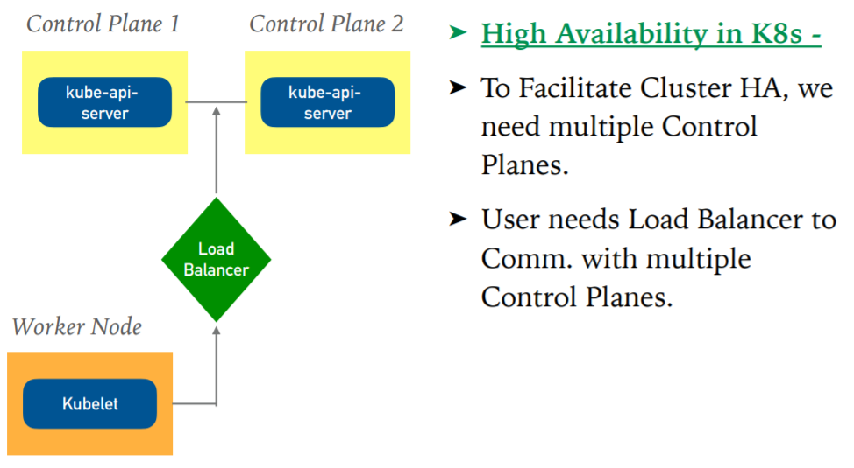
Notes:
Stacked Etcd is a way in which all etcd are linked to each other or use external etcd which is maintained separately .

Slide 25
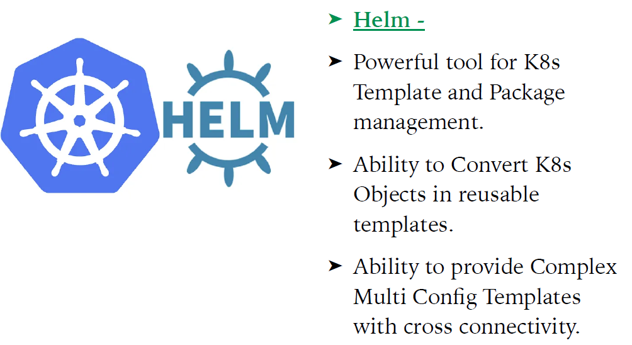
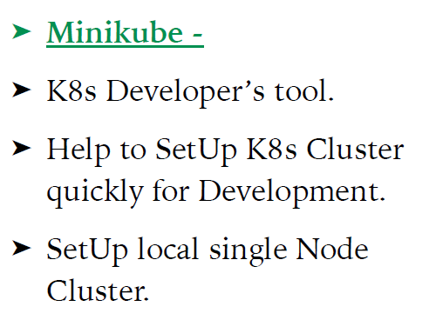
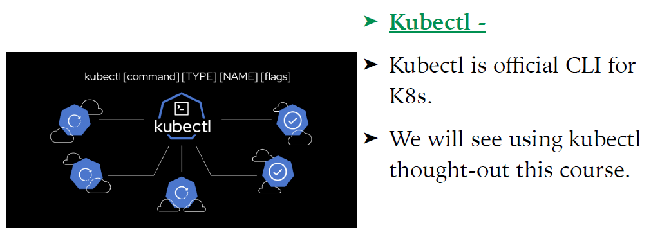
Notes:
➤ K8s Management Tools : K8s tools provide Additional functionality.
➤ Kubectl
➤ Kubeadm
➤ Minikube
➤ Helm
➤ Kompose
➤ Kustomize

Slide 26
Notes:
kubeadm token create --print-join-command
kubeadm token list

Slide 27
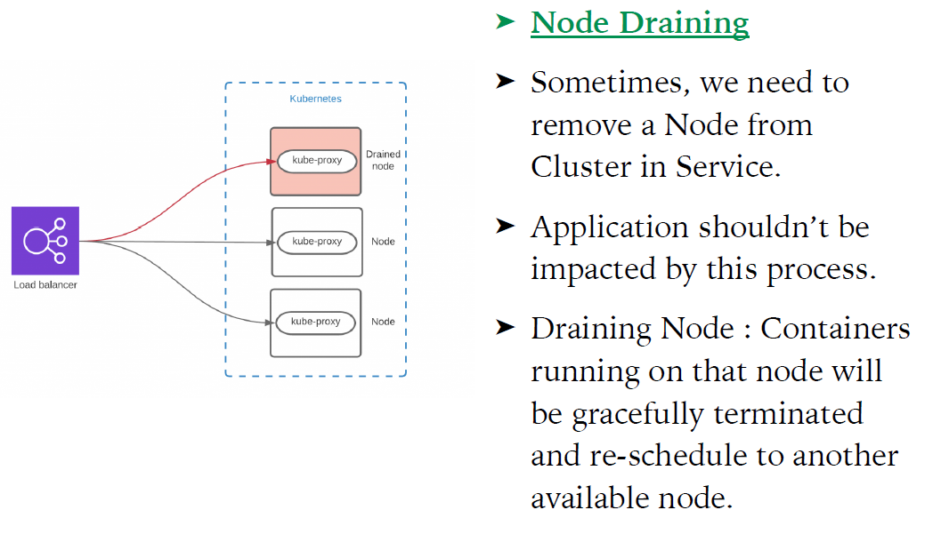
Notes:
Node Draining :
-----------------
Command : kubectl drain <NODE> --ignore-deamonsets --force
To join back : kubectl uncordon <NODE>

Slide 28
Notes:
kubectl api-resources
Commands : Upgrade Kubernetes Cluster
***************** Upgrade Control Plane Node ******************
1. Get the Running Node and Version
kubectl get nodes
2. Drain Master Node
kubectl drain <node-to-drain> --ignore-daemonsets
3. Upgrade kubeadm
sudo apt-get update
sudo apt-get install -y --allow-change-held-packages kubeadm=1.21.1-00
4. Verify that the download works and has the expected version:
kubeadm version
5. Verify the upgrade plan
sudo kubeadm upgrade plan v1.21.1-00
6. Apply the Upgrade
sudo kubeadm upgrade apply v1.21.1
7. Upgrade kubelet and kubectl packages
sudo apt-get update
sudo apt-get install -y --allow-change-held-packages kubelet=1.21.1-00 kubectl=1.21.1-00
8. Restart the kubelet:
sudo systemctl daemon-reload
sudo systemctl restart kubelet
10. Get the Running Node and Version
kubectl get nodes
11. Uncordon the Node
kubectl uncordon <node-to-uncordon>
***************** Upgrade Worker Node ******************
1. Drain Worker Node
kubectl drain <node-to-drain> --ignore-daemonsets --force
2. Upgrade kubeadm
sudo apt-get update
sudo apt-get install -y --allow-change-held-packages kubeadm=1.21.1-00
3. Verify that the download works and has the expected version:
kubeadm version
4. For worker nodes this upgrades the local kubelet configuration
sudo kubeadm upgrade node
5. Upgrade kubelet and kubectl packages
sudo apt-get update
sudo apt-get install -y --allow-change-held-packages kubelet=1.21.1-00 kubectl=1.21.1-00
6. Restart the kubelet:
sudo systemctl daemon-reload
sudo systemctl restart kubelet
7. Get the Running Node and Version
kubectl get nodes

Slide 29
Notes:
See inside the container :
kubectl exec <> -c nginx -- cat /etc/nginx/nginx.conf
kubectl describe pod <pod-name>
kubectl delete <>

Slide 30
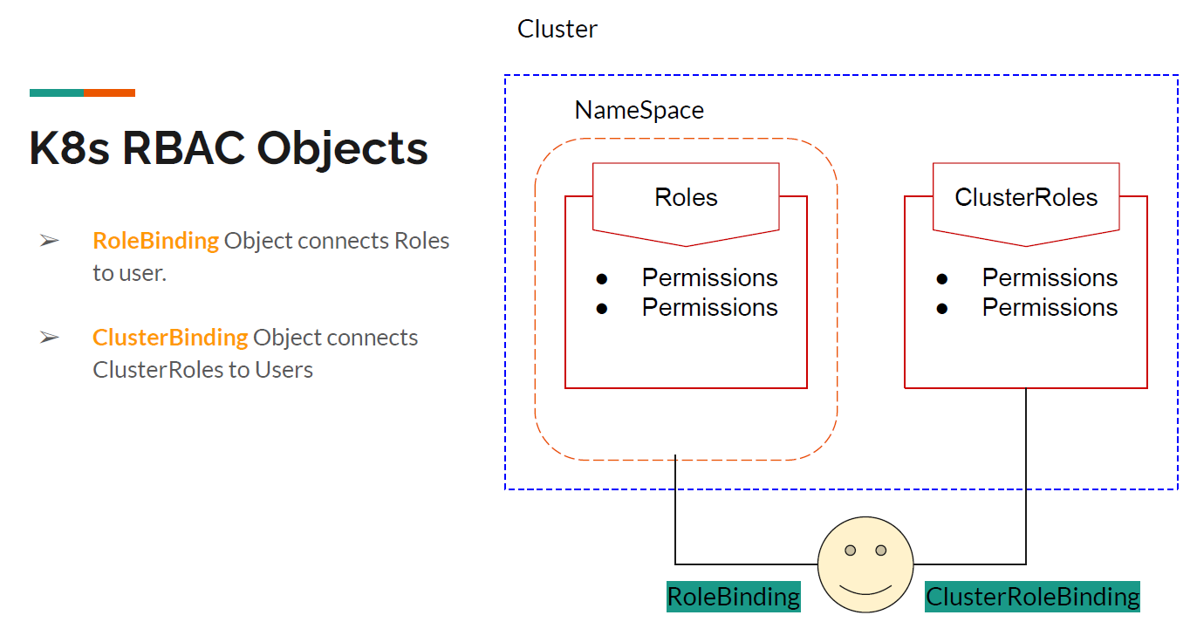

Slide 31
